Slide 1
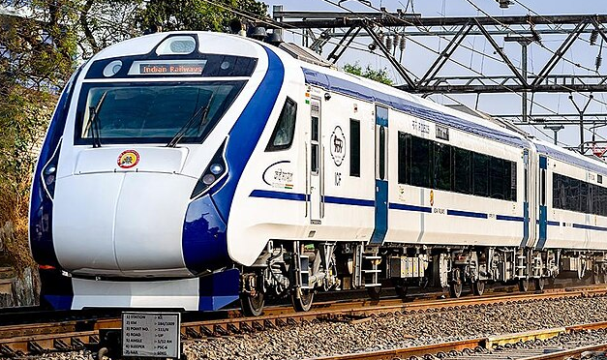
Railway ticket booking system
Prepared by : Bikram Pal
Avinash Jha
Ayan Banerjee
Aniket Ghosh

Slide 2
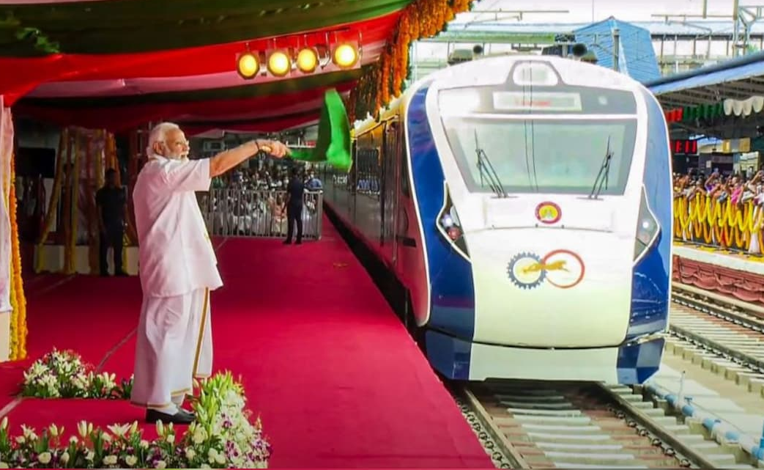
Objective
The seat allocation should start from the middle position of bogie to maintain a balanced load. Senior Citizens must be allotted lower berth. Persons from single family should be together if possible.

Slide 3
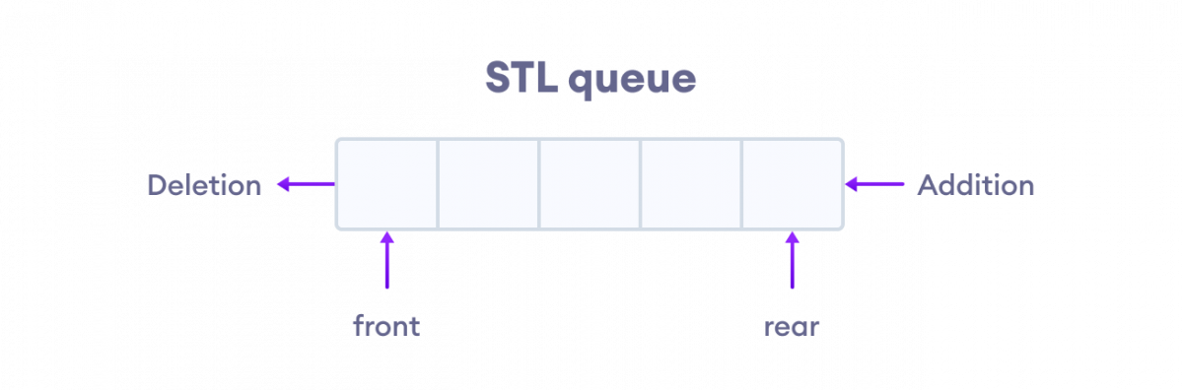



Solution
Utilizing a Priority Queue for efficient seat allocation based on specified criteria.
Priority is set on the basis of number of people in the family.
E.g;
[
{"name":"bikram","age":25,"gender":"male"},
{"name":"avinash","age":29,"gender":"male"},
]
[
{"name":"aniket","age":38,"gender":"male"}
]
[
{"name":"ayan","age":69,"gender":"others"}
]

Slide 4
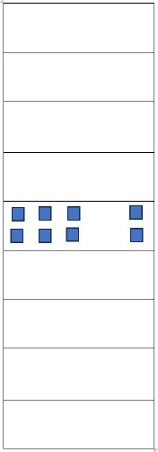
Iteration
Bogie is divided into 9 compartments .
Seat allocation starts from the middle compartment.
If seat is found vacant then it is booked .
Else iteration moves to the upper compartment and vacancy is checked. If found, seat is booked else iteration moves to lower compartment( below middle ).
If the lower compartment is full then iteration moves to the upper compartments above last checked compartment and the iteration continues until seat is found.
If seat is not found then the passenger name is added to the waiting list.

Slide 5
THANK YOU

